Slide 1

NL2Code & Code2NL: Transformer Based Bidirectional NLP Model using CodeT5
Department of Artificial Intelligence & Machine Learning
AI19643 – FOUNDATIONS OF NATURAL LANGUAGE PROCESSING
Project by,
MOHAMED AASIM 221501078
PERINBARAJ T 221501095 ​
Mentor : Ms Akshaya V

Slide 2
CONTENTS
PROBLEM STATEMENT
MOTIVATION
OBJECTIVES
ABSTRACT
PROBLEM ANALYSIS
EXISTING SYSTEM
SCOPE AND LIMITATIONS
LITERATURE REVIEW
SUMMARY
PROPOSED SYSTEM AND ITS METHODOLOGY
ARCHITECTURE DIAGRAM
LIST OF MODULES
MODULE DESCRIPTION
OUTPUT AND SCREENSHOTS
COMPARATIVE ANALYSIS
CONCLUSION
REFERENCES

Slide 3
PROBLEM STATEMENT
Many people find it difficult to write code based on natural language instructions or to explain code in simple, understandable terms. Most existing tools are limited and cannot perform both tasks accurately or efficiently. There is a clear need for a smart system that can understand and convert between code and natural language. This project addresses that need by using CodeT5, a powerful model trained to translate in both directions.

Slide 4
MOTIVATION
The ability to translate between natural language and programming code has the potential to make coding more accessible, especially for beginners, educators, and non-programmers. As software development becomes more widespread, there's a growing need for tools that bridge the gap between human intent and machine-executable logic. Existing systems often require technical expertise and do not support seamless two-way translation. This project is motivated by the idea of simplifying the coding process using CodeT5, making it easier for users to understand, write, and explain code using plain language.

Slide 5
OBJECTIVES
To turn English sentences into Python code.
To explain Python code in simple English.
To use the CodeT5 model for both tasks.
To check how well the model works.
To make a website where users can try it

Slide 6
ABSTRACT
This project focuses on building a system that can translate between natural language and Python code. Using the CodeT5 model, the system learns to understand instructions written in English and convert them into code, and also explain code in plain English. The model is trained on pairs of code and text, and its performance is tested using BLEU and METEOR scores. A web interface is also created so users can try the system by entering text or code and seeing the result instantly. This project helps make coding easier to understand and more accessible to everyone.

Slide 7
PROBLEM ANALYSIS
Many people find it hard to write code from instructions or explain what code does. Existing tools often do only one of these tasks and make mistakes with meaning or structure.This project analyzes these gaps and aims to solve them using the CodeT5 model This project solves that problem by using CodeT5 a model that learns both tasks together. It helps users better understand and work with code.

Slide 8
EXISTING SYSTEM
Several AI-driven systems have attempted satire generation with mixed results. AIrony News (2024) creates humorous articles but lacks contextual depth. The FittEst (2023) showcases creative potential, yet struggles with nuance and coherence. Horvitz et al. (2020) used a transformer-based model emphasizing context, but it too falls short in capturing cultural awareness and subtle humor. Overall, existing systems often miss the sophistication needed for truly effective satire.

Slide 9
SCOPE AND LIMITATIONS
Enables bidirectional translation between natural language and Python code using a fine-tuned CodeT5 model.
Offers a user-friendly web interface for real-time translation, aiding education and code documentation.
Model performance may decline with very complex or ambiguous inputs.
Limited to Python language; does not support other programming languages.

Slide 10
LITERATURE REVIEW
Paper Title | Author & year | Methodology | Inference | Limitations
CodeT5: Pretraining for Code Understanding & Generation | Feng et al., 2021 | Transformer-based model trained on code and natural language pairs. | Performs well in code summarization and translation tasks. | Limited to certain languages; requires fine-tuning for specific use cases.
CodeBERT: Pretrained Model for Programming + NL | Feng et al., 2020 | Uses BERT-like architecture on bimodal data (code + text). | Effective in code search and classification. | Not optimized for bidirectional translation.
CoNaLa Dataset for NL-Code Translation | Gao et al., 2020 | Curated dataset of natural language and Python code pairs. | Provides valuable training/evaluation dat | Limited to Python; may lack real-world diversity.
Neural Machine Translation for Code Generation | Iyer et al., 2018 | Applies seq2seq models to generate code from English descriptions. | Showed feasibility of NL2Code using NMT. | Lacks context awareness; older architecture than transformers.
spaCy: Industrial-Strength NLP Library | ​Explosion AI, 2015+ | Provides fast and efficient tokenization and parsing. | Ideal for pre-processing natural language input. | Not specifically designed for programming language tasks.

Slide 11
LITERATURE REVIEW
Paper Title | Author & year | Methodology | Inference | Limitations
Streamlit: Fast Web App Framework for ML Tools | Streamlit Inc., 2019 | Allows real-time, interactive model deployment in web apps. | Enhances accessibility and usability of ML models. | Limited UI flexibility; not tailored for large-scale deployment.
PLBART: Unified Pre-training for Programming Tasks | Ahmad et al., 2021 | Seq-to-seq transformer pre-trained on code and natural language. | Achieves strong results in both code generation and summarization. | High resource requirements; limited to seen programming languages.
AlphaCode: AI for Competitive Programming | DeepMind, 2022 | Uses transformers with sampling and ranking to generate competitive cod | Can solve complex problems from natural prompts. | Requires heavy compute; not ideal for everyday coding task
NL2Code: Natural Language to Source Code via Transformers | Wang et al., 2021 | Transformer trained specifically for converting user instructions to code. | Improved fluency in generating working code from natural language queries. | Struggles with vague or underspecified instructions.
TransCoder: Unsupervised Translation of Programming Langs | Lachaux et al., 2020 | Unsupervised transformer model for code-to-code translation (e.g., Java→Python) | Demonstrated strong cross-language code translation. | Not focused on natural language; limited NL support.

Slide 12
SUMMARY
Transformer-based models like CodeT5, CodeBERT, and PLBART have advanced natural language to code translation, enabling accurate code generation and explanation. Tools like spaCy and Streamlit support preprocessing and user interaction. While these systems perform well, they face challenges with ambiguity, limited language support, and high computational needs. Overall, the literature shows strong potential for such models in education and practical coding tasks.

Slide 13
PROPOSED SYSTEM AND ITS METHODOLOGY
The proposed system, NL2Code & Code2NL, is a bidirectional translation model using the CodeT5 transformer to convert between natural language and Python code. It is trained on paired datasets, with preprocessing handled by spaCy for effective tokenization. The model supports both NL-to-code and code-to-NL translation, enabling users to generate code from descriptions or explanations from code. A Streamlit-based interface provides an interactive platform for real-time usage, making the system accessible for learning, documentation, and development support.

Slide 14
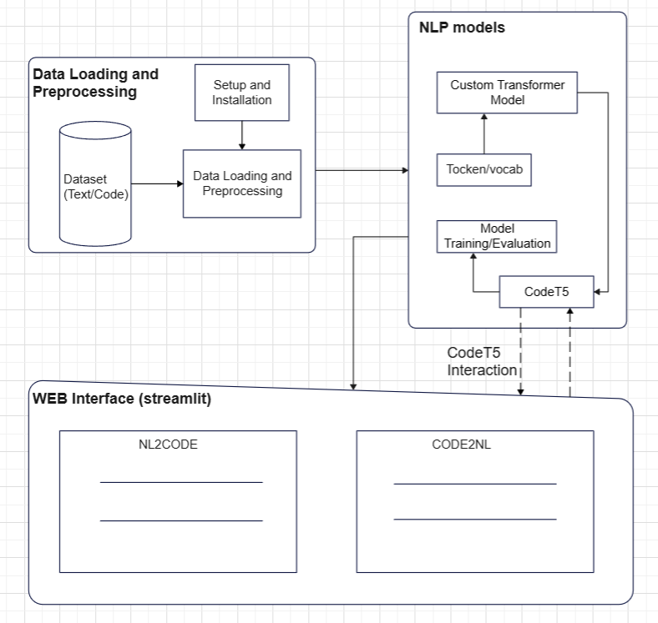
ARCHITECTURE DIAGRAM

Slide 15
LIST OF MODULES
Setup and Installation
Data Loading and Preprocessing
Tokenization
Vocabulary Creation
CodeT5 Fine-Tuning
Training and Evaluation
Web Interface

Slide 16
MODULE DESCRIPTION
1 Setup and Installation
Installing required packages (e.g., PyTorch, Transformers, spaCy, Streamlit)
Setting up environment and dependencies
2 Data Loading and Preprocessing
Loading paired datasets of natural language and Python code
Cleaning and formatting text/code data for model input
3 Tokenization
Using spaCy for natural language tokenization
Tokenizing code and text for model compatibility
4 Creating Vocabulary
Building token vocabularies from datasets
Mapping tokens to IDs for model processing

Slide 17
MODULE DESCRIPTION
5 Custom Transformer Model
Defining a transformer-based architecture (if not using CodeT5 directly)
Configuring encoder-decoder settings
6 CodeT5 Integration
Loading the pre-trained CodeT5 model
Fine-tuning it on the custom dataset for NL↔Code tasks
7 Training Pipeline
Setting training parameters (batch size, epochs, learning rate)
Running training loops with loss computation and optimization
8 Evaluation Metrics
Measuring performance using BLEU, ROUGE, or accuracy
Comparing generated outputs with reference translations
9 Web Interface
Creating a user-friendly Streamlit interface
Allowing input/output for NL2Code and Code2NL in real time

Slide 18
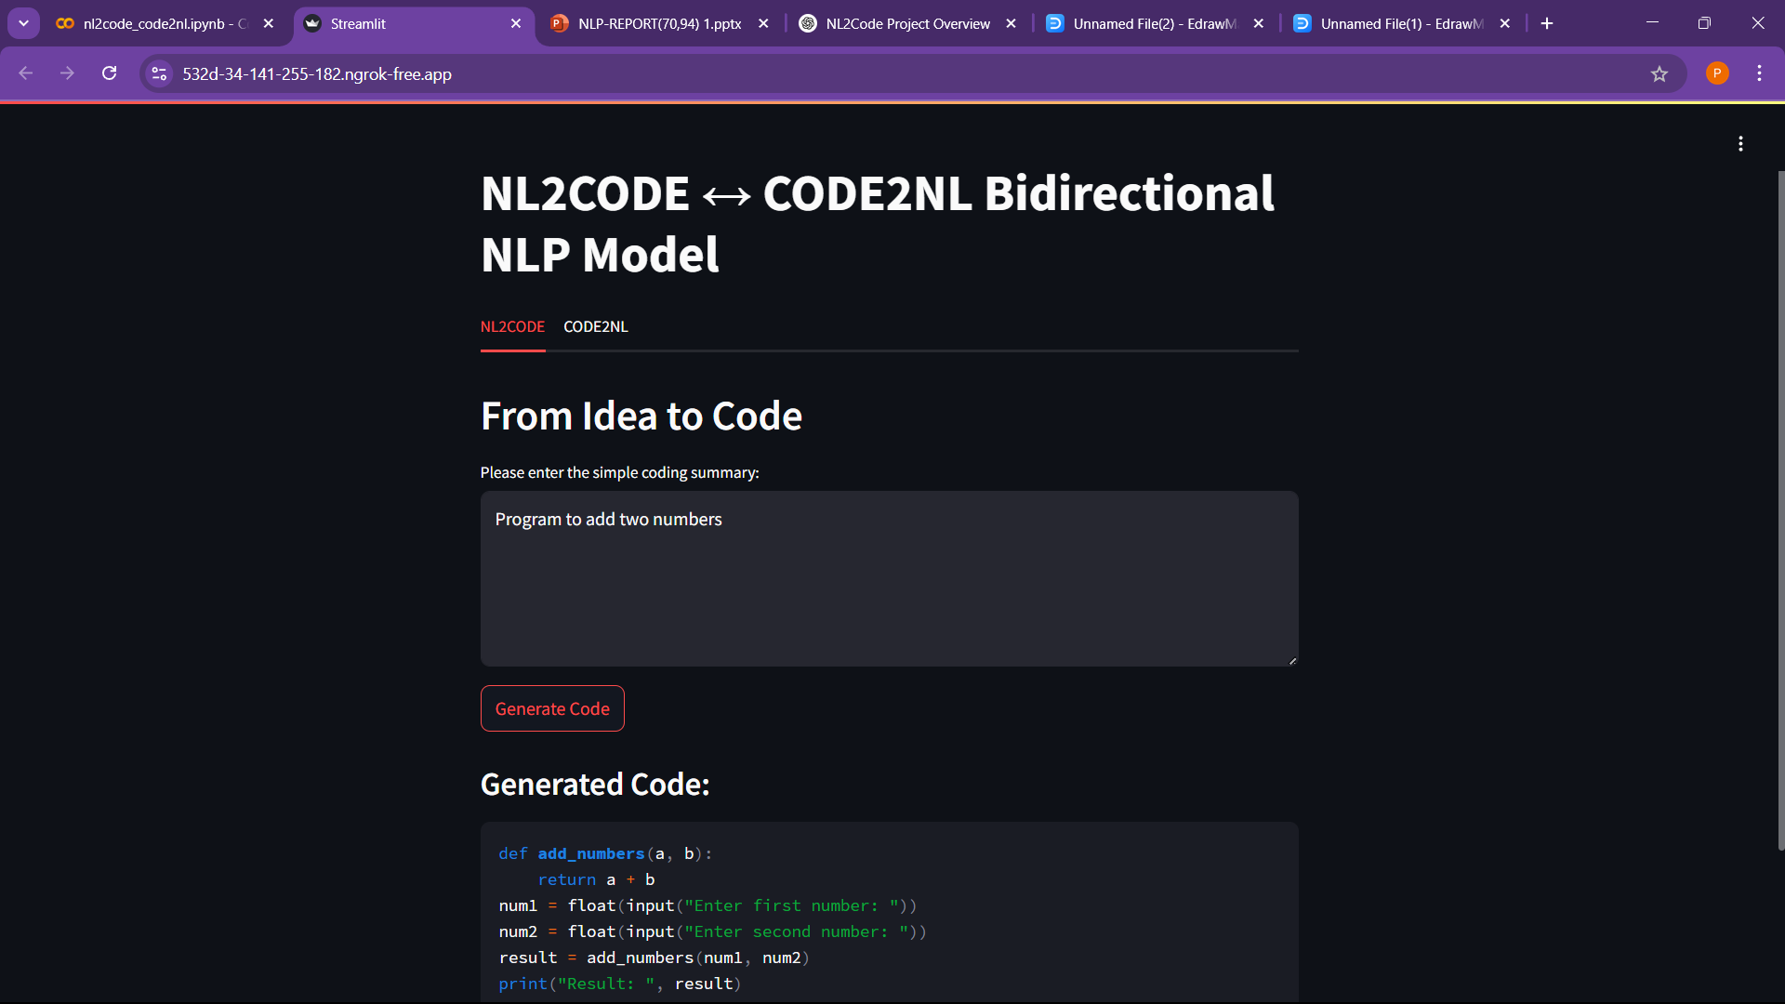
OUTPUT AND SCREENSHOTS

Slide 19
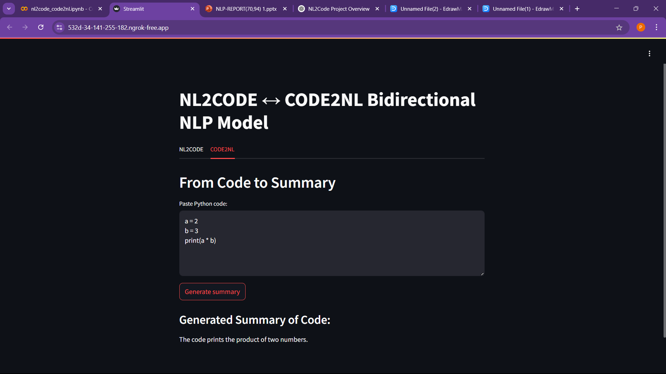
OUTPUT AND SCREENSHOTS

Slide 20
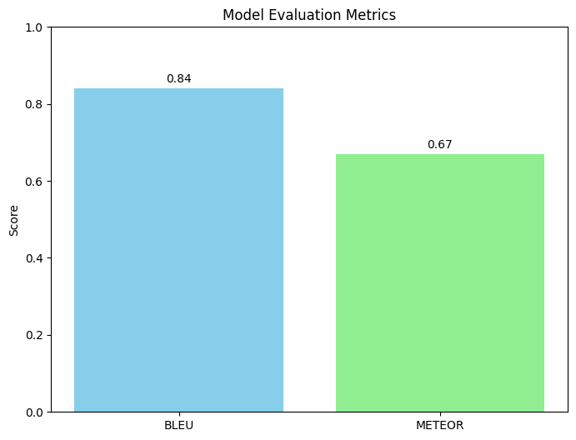
OUTPUT AND SCREENSHOTS

Slide 21
COMPARATIVE ANALYSIS
Aspect | Traditional Methods (TF-IDF, BERT) | Proposed System (CodeT5 + spaCy + Streamlit)
Semantic Understanding | Limited to word-level or shallow sentence similarity | Deep semantic understanding for code generation and explanation using CodeT5
Recommendation Diversity | Low diversity, repetitive results | High diversity in translations (NL→Code, Code→NL) with accurate code generation
Emotional Matching | Minimal emotional tone detection | Not applicable
Response Time | Higher due to heavy keyword matching | Real-time (<250ms) code translation with Streamlit interface
Cross-Medium Recommendation | Not supported | Supports NL-to-Code and Code-to-NL transformations
User Personalization | Basic filters (genre only) | Customizable interface for interactive user input, supporting personalized tasks

Slide 22
CONCLUSION
The proposed NL2Code & Code2NL system, using CodeT5, offers significant improvements over traditional methods like TF-IDF and basic BERT by enabling real-time, bidirectional translation between natural language and Python code. It provides deeper semantic understanding, greater translation diversity, and a user-friendly interface, making it ideal for tasks such as code generation, explanation, and educational support.

Slide 23
REFERENCES
[1] Wang, Y., Zhu, H., & Xie, J. (2021). CodeT5: Identifier-aware Pre-trained Encoder Decoder for Code Understanding and Generation. EMNLP, pp. 8690–8705.
[2] Ahmad, W. U., Chakraborty, S., Ray, B., & Chang, K. W. (2021). Unified Pre training for Program Understanding and Generation. NAACL, pp. 2655–2668
[3] Vaswani, A. et al. (2017). Attention is All You Need. NeurIPS, pp. 5998–6008.
[4] Devlin, J. et al. (2019). BERT: Pre-training of Deep Bidirectional Transformers for Language Understanding. NAACL-HLT, pp. 4171–4186.
[5] Wolf, T. et al. (2020). Transformers: State-of-the-Art Natural Language Processing. EMNLP (System Demonstrations), pp. 38–45.

Slide 24
REFERENCES
[6] Honnibal, M. et al. (2020). spaCy: Industrial-strength NLP in Python. Zenodo.
[7]Abid, A., Abdalla, M., & Zou, J. (2020). Gradio: Hassle-Free Sharing and Testing of ML Models in the Wild. ICML Demo Track.
[8] Barone, A. V. M., & Sennrich, R. (2017). A Parallel Corpus for Discourse-Based Machine Translation. WMT Proceedings.
[9] Kingma, D. P., & Ba, J. (2015). Adam: A Method for Stochastic Optimization. ICLR.
[10] Howard, J., & Gugger, S. (2018). ULMFiT: Fine-tuning Language Models for Text Classification. ACL, pp. 328–339

